Slide 1
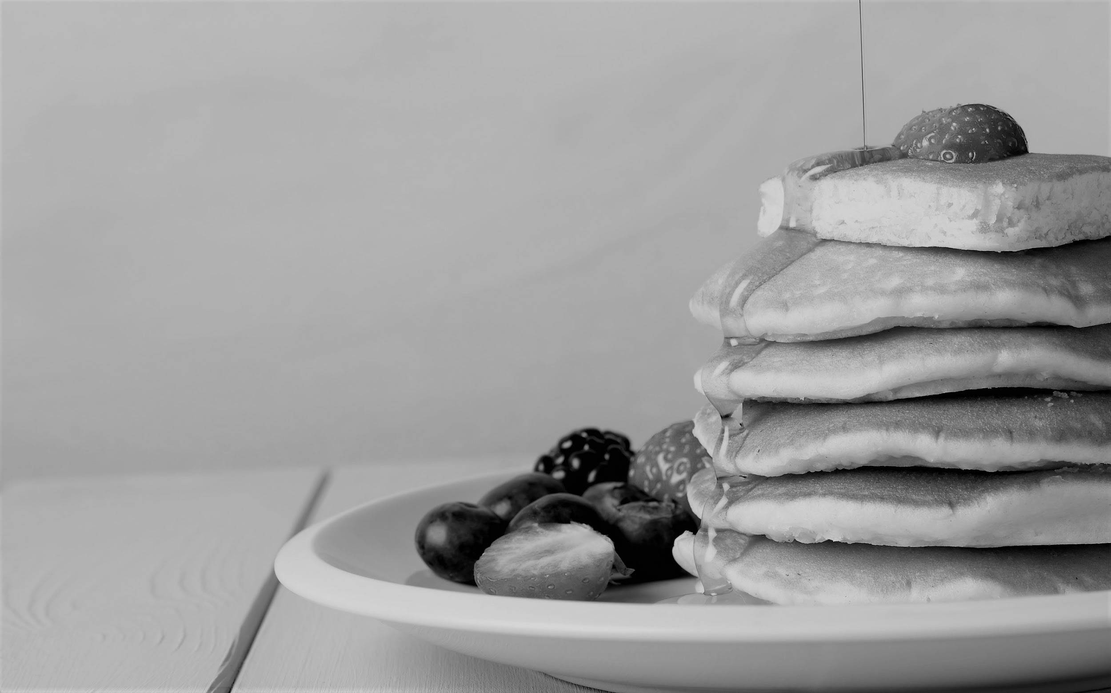
TO FLIP OR NOT TO FLIP
An investigation of Sorting by Prefix Reversals through the Pancake Problem

Slide 2



THE CHEFS
Sai Chinthala
Aaron Fox
Abby Spalding

Slide 3
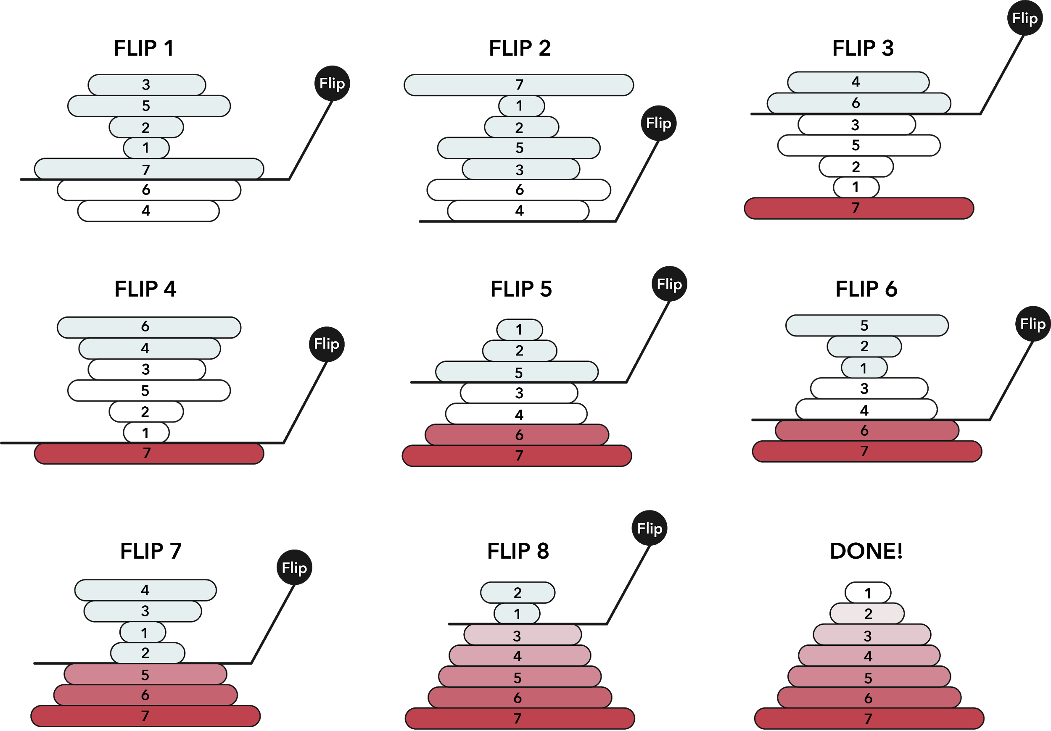
Sorting by Prefix Reversal
General Idea:
Reversing (flipping) a string of characters (pancakes) at a specific index. Repeated at varied indexes until the string is sorted.
How it Works

Slide 4
Origin of Pancake Flipping
1920-1930s
1975
1978
1993
2008
Emergence of studying Genetic Inversions:
“Flipping blocks of genes end-over-end.”
Pioneered by Theodosius Dobzhansky and Alfred H. Sturtevant
Jacob E. Goodman introduces the problem of flipping pancakes under the pseudonym Harry Dweighter
(Original, naive upper bound of 2n)
Christos H. Papa­dimitriou and Bill Gates improved the upper bound for Reversal Sorting to (5n+5)/3 moves and lower of (17/16)n moves
Combinatorial problem of Sorting by Reversals, aligning with Genome Rearrangement by Inversion Introduced by Kececioglu and Sankoff
Group of Researchers at University of Texas at Dallas further improved the upper bound to 18n/11. Lower bound had been improved to 15n/14

Slide 5
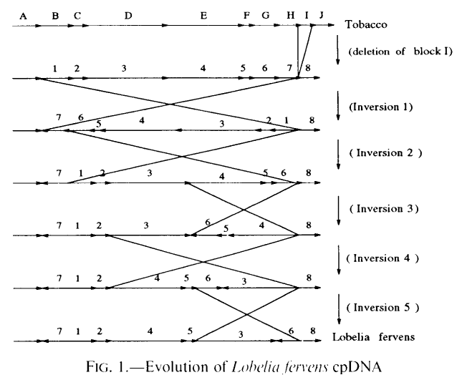
Genome Inversions vs Prefix Sorting
Not limited to prefix inversions
Geneticists want to know the reversal (evolutionary) distance between particular gene configurations seen in nature [2]
Can also evolve by deletion, insertion, and duplication of fragments

Slide 6
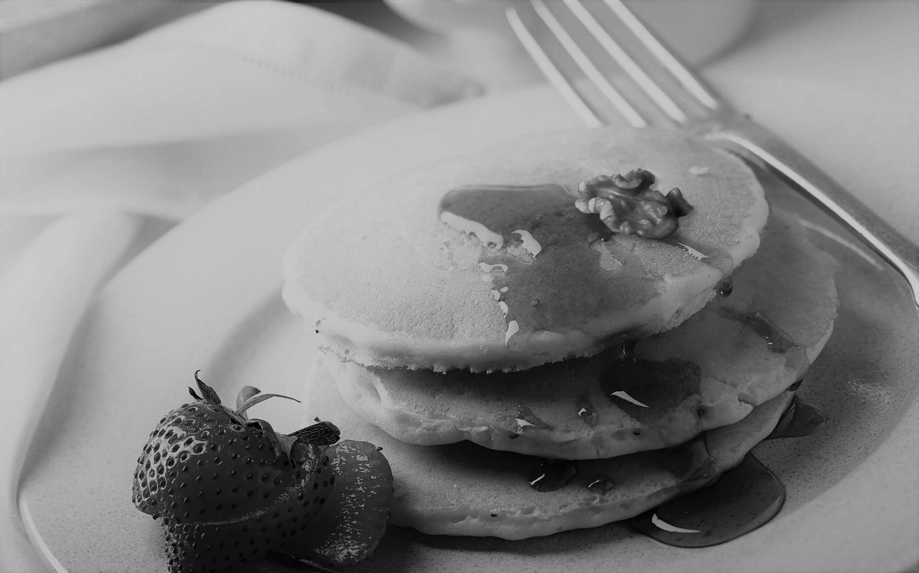
OUR IMPLEMENTATION

Slide 7
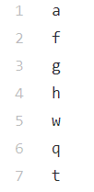
Data
Text file with random order of pancake ‘sizes’
The original NP problem was using string reversals - the letters were converted to integer numbers to get pancake size
Strings were used because symbols can repeat, which can reduce number of prefix reversals required
Different size files were tested to compare results
Letters were converted to ASCII equivalent to get ‘size of pancakes’

Slide 8
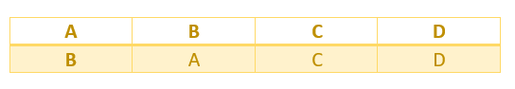
Chromosomes
Initial chromosomes are created given the population size
The upper bound of indices needed for pancake sorting is 18n/11 - size of the chromosomes
First, every possible index to flip will be included, then additional indices (repetitive indices) will be added
Ex. Flip at Index 1

Slide 9
THE FITNESS
FUNCTION
Iterates through list of pancakes to count number of subsequent pancakes
Compares list to sorted list
The fittest chromosome is the one where:
it has the most and longest subarrays
the distance of each pancake from its index in the sorted version of the list is smallest

Slide 10
Roulette Wheel Selection
Used to find parents for crossover and mutation operators
Cost of each chromosome in given population is added to an array of costs
The cost is then divided by the total cost of every chromosome
Each value in the roulette wheel is divided by the inverted sum of the costs
Python’s random function applies weights to the chromosomes in the current population and results in 2 fit chromosomes to use as parents

Slide 11
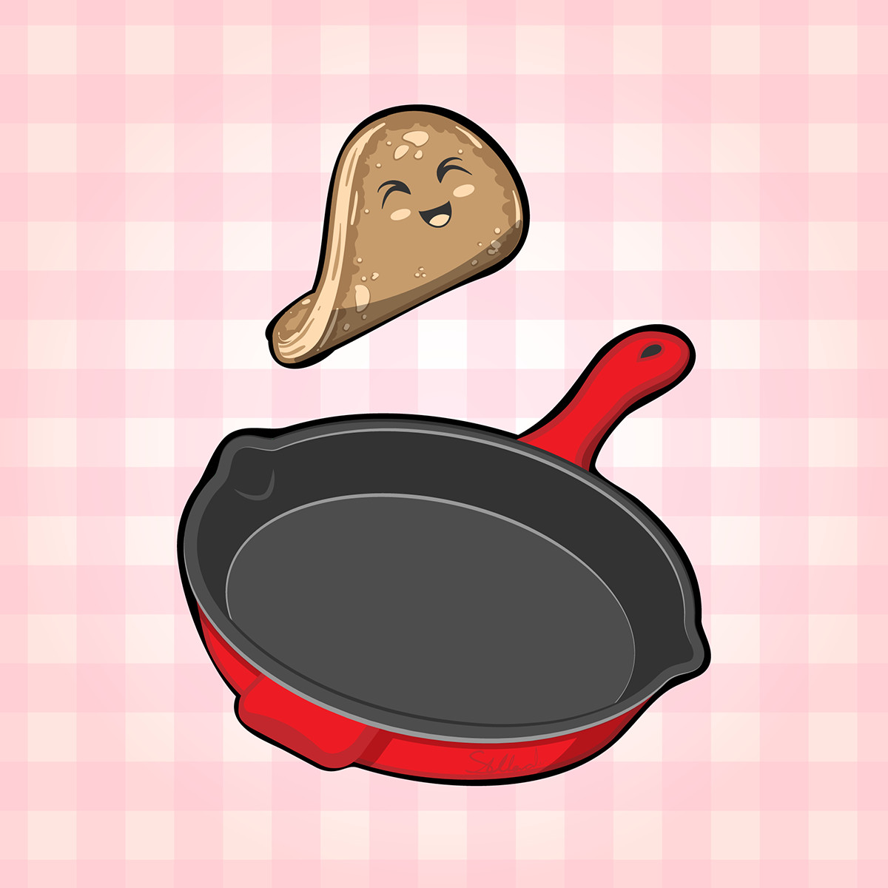
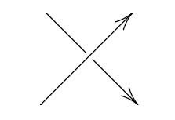
Crossover Operator
Single point crossover
Selects random index in list of chromosomes and ‘flips’ the list (pancakes) at that index
The cost of the resulting offspring is calculated using fitness function

Slide 12
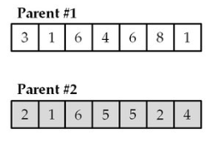
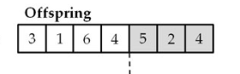
Crossover Operator
Single point crossover (Con’t)

Slide 13
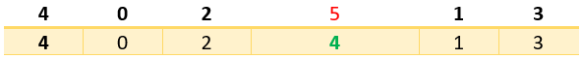
Mutation
Operator
Optimal Mutation Probability = .01
The chromosome is selected by the roulette wheel selection to be mutated

Slide 14
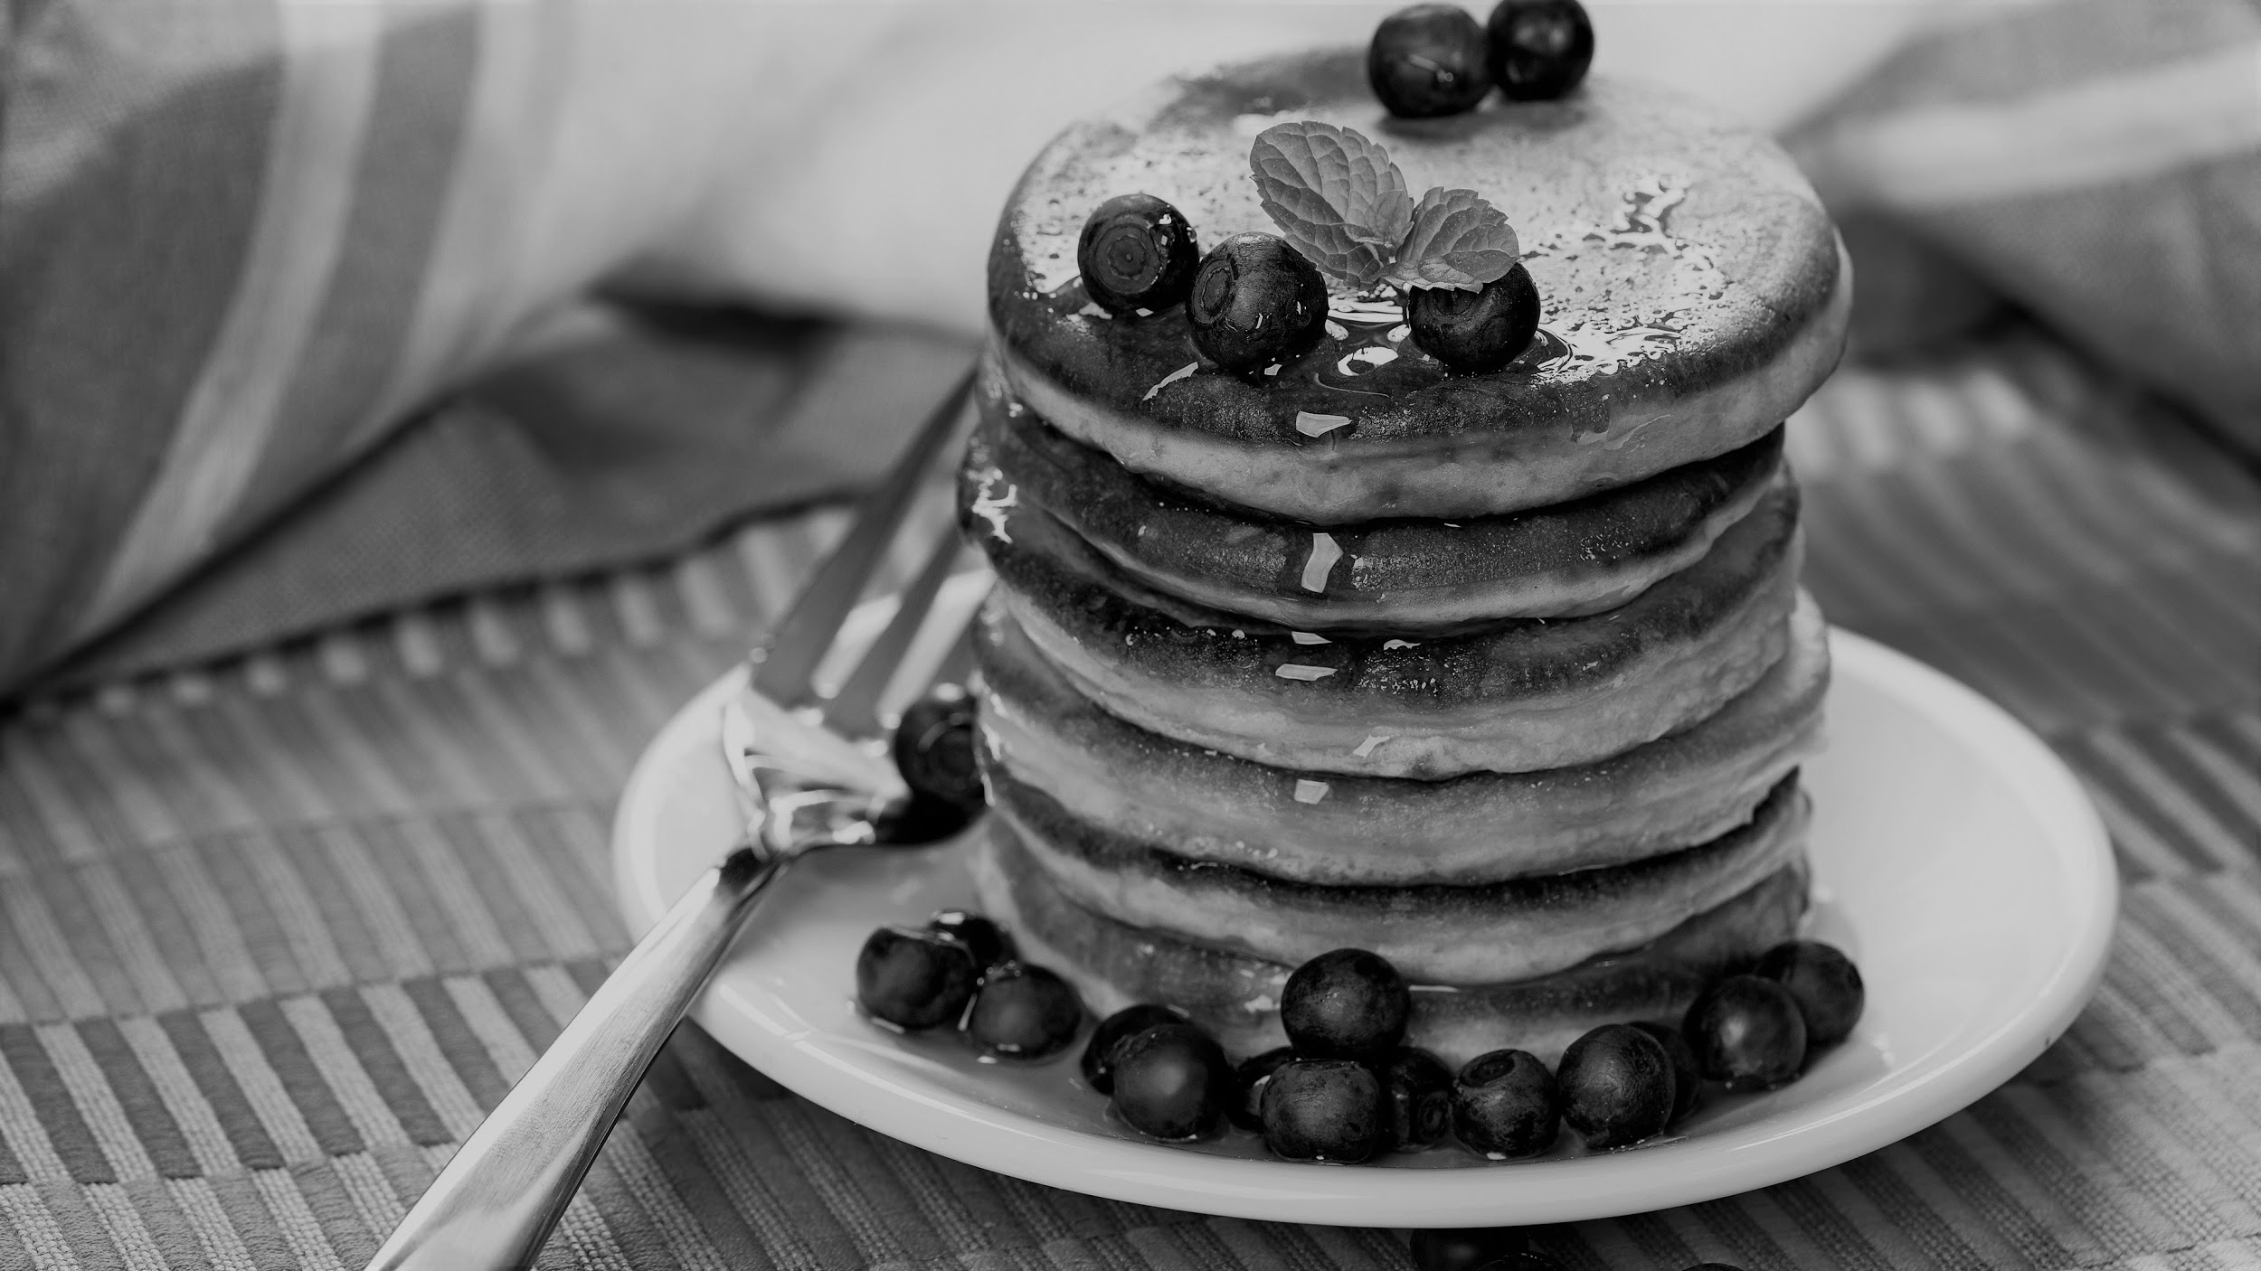
WISDOM OF CROWDS

Slide 15
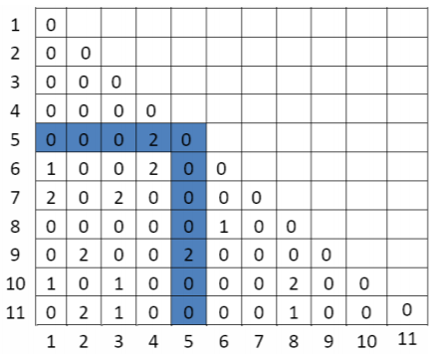
Wisdom of Crowd Drawbacks
Traveling Salesman Approach
Since order of flips mattered, could not use a aggregation method similar to TSP.

Slide 16
Final
Implementation
The pancake flipping problem is NP Complete only if the number of flips to order the pancakes is found.
Keep a list of number of flips
Find the minimum
“Who wants to be a Millionaire?”
approach

Slide 17
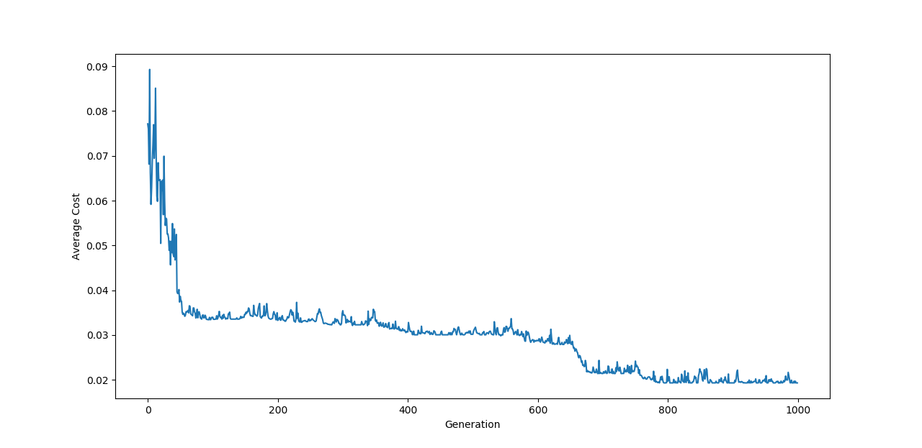
Results
Running a Single GA
This is a GA run on a string of 50 letters with a population of 50. As more generations are run, the cost continually goes down and more efficient solutions with fewer flips are found.

Slide 18
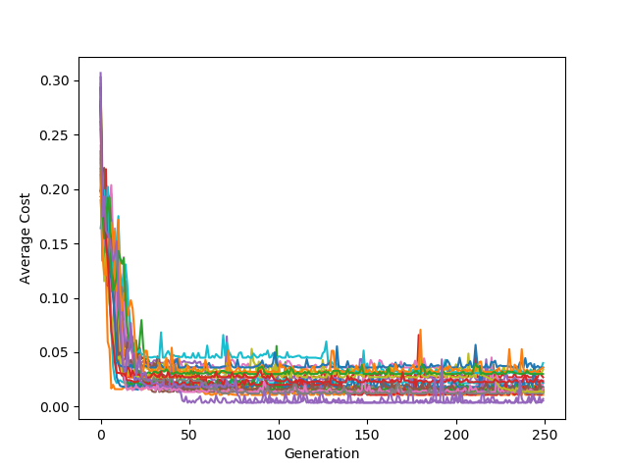
Results
Wisdom of Crowds Using 25 GAs
Here, the costs of running the Wisdom of Crowds approach over 25 GAs is laid out. The purple line found the most fit indices for flipping the string, flipping a string of size twenty a minimum of 21 times, giving us the lower bound for the given string.

Slide 19
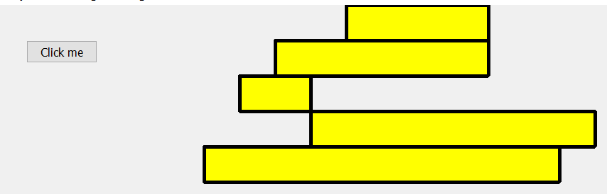
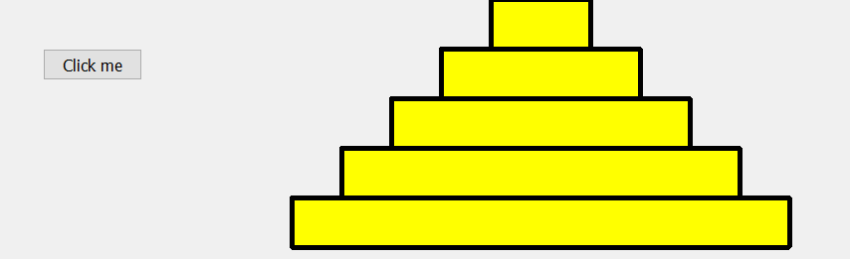
Results
Example with 5 Pancakes
Size 1,2,3,4,5
Original Order: 3,2,1,4,5
1 Flip at index 2
GUI Representation of 5 sorted pancakes

Slide 20
Results
We are Currently Waiting for more results which describe the key differences between using the WoC approach with the GAs versus just the GAs, differences in sizes of strings, time taken to run, comparisons of using the distance_weight vs subarray_weight in the cost functions, etc.

Slide 21
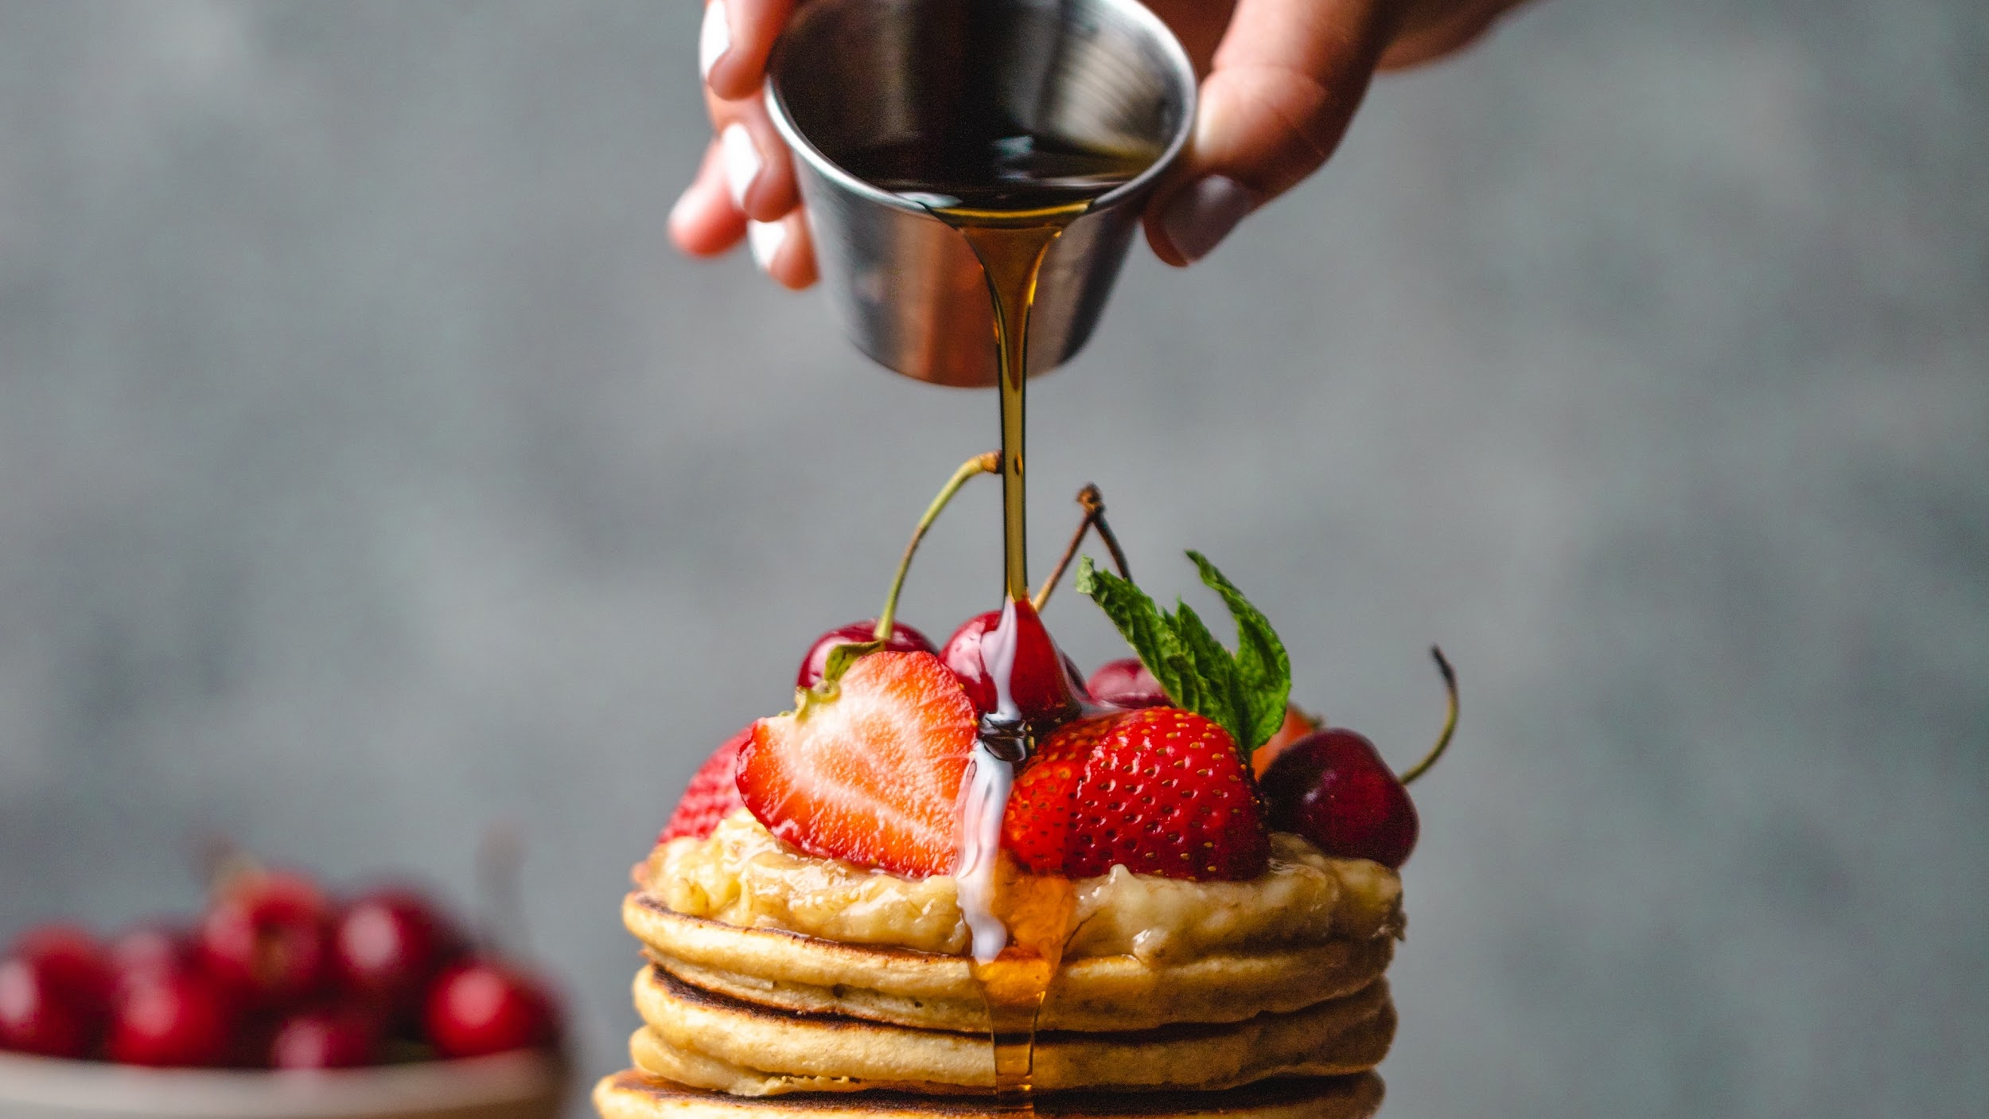
THANK YOU
PRESENTATION TEMPLATE SLIDESMANIA

Slide 22
Resources
[1] P. Compeau, “Sorting by Signed Reversals,” unpublished.
[2] Hayes, Brian. “Sorting Out the Genome.” American Scientist, vol. 95, no. 5, 2007, pp. 386–387.
[3] Bafna, Vineet, and Pavel A Pevzner. “Sorting by Reversals: Genome Rearrangements in Plant Organelles and Evolutionary History of X Chromosome.” Molecular Biology and Evolution, 1995.
[4] Heyer, Laurie J., et al. “Bacterial Computing: Using E. Coli to Solve the Burnt Pancake Problem.” Math Horizons, vol. 17, no. 3, 2010, pp. 5–10.
[5] Gates, William H., and Christos H. Papadimitriou. “Bounds for Sorting by Prefix Reversal.” Discrete Mathematics, vol. 27, no. 1, 1979, pp. 47–57.
[6] B. Chitturi, et al. “An (18/11)n upper bound for sorting by prefix reversals.” Theoretical Computer Science, 2009, pp. 3372–3390.

